Slide 1
Feasibility Study
By
Dr. Junaid Akram

Slide 2
Feasibility Analysis
Feasibility – the measure of how beneficial or practical an information system will be to an organization.
Feasibility analysis – the process by which feasibility is measured.
Notes:
No additional notes.

Slide 3
Feasibility Checkpoints
Planning
Planned Project
Existing System
Support
Analysis
Production
System
Business
Requirements
Implementation
Design
Technical
Design

Slide 4
Feasibility Checkpoints
Existing System
Planning
Planned Project
Support
Analysis
Production
System
Business
Requirements
Implementation
Technical
Design
Design
systems analysis -- study
urgency? rough cost estimate
systems analysis -- definition
clearer scope, refined cost estimate
systems design -- selection
adjust scope, schedule, costs
systems design -- procurement
option check before letting contracts
systems design -- detail design
one last chance to cancel or downsize

Slide 5
Six Tests For Feasibility
Operational feasibility – a measure of how well a solution meets the system requirements.
Cultural (or political) feasibility - a measure of how well a solution will be accepted in an organizational climate.
Technical feasibility – a measure of the practicality of a technical solution and the availability of technical resources and expertise.
Schedule feasibility – a measure of how reasonable the project timetable is.
Economic feasibility - a measure of the cost-effectiveness of a project or solution.
Legal feasibility - a measure of how well a solution can be implemented within existing legal/contractual obligations.
Notes:
Conversion Notes
Cultural (or political) feasibility and legal feasibility are new to the seventh edition.
Teaching Notes
It is useful to take an example information system and explain how it might fail each test of feasibility. For example, a payroll system might fail legal feasibility for a multi-national corporation faced with national laws regarding the exportation of employee data.
Emphasize that all candidates should be analyzed according to all of the above criteria.
Students should understand that rarely will any one candidate solution be the most feasible candidate according to all criteria.

Slide 6
Operational Feasibility
How well proposed system solves the problems and takes advantage of opportunities identified during the scope definition and problem analysis phases
How well proposed system satisfies system requirements identified in the requirements analysis phase
Is the problem still worth solving?
Notes:
Conversion Notes
This is a new slide in the seventh edition.

Slide 7
Cultural (or political) feasibility
Does management support the system?
How do end users feel about their role in the system?
What end users may resist or not use the system? How can this be overcome?
How will the working environment change? Can users and management adapt to the change?
Notes:
Conversion Notes
This is a new slide in the seventh edition.

Slide 8
Technical feasibility
Is the proposed technology or solution practical?
Do we currently possess the necessary technology?
Do we possess the necessary technical expertise?
Notes:
Conversion Notes
This is a new slide in the seventh edition.

Slide 9
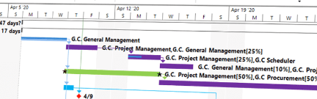
Schedule feasibility
Are specified deadlines mandatory or desirable?
Are mandatory deadlines realistic for proposed solution?
Notes:
Conversion Notes
This is a new slide in the seventh edition.

Slide 10
Economic feasibility
During Scope Definition
Do the problems or opportunities warrant the cost of a detailed study and analysis of the current system?
During Problem Analysis
After a detailed study of the current system, Better estimates of development costs and benefits
During Decision Analysis
Requirements now defined
Development costs can be better estimated
Notes:
Conversion Notes
This is a new slide in the seventh edition.

Slide 11
Legal feasibility
Copyrights
Union contracts
Legal requirements for financial reporting
Antitrust laws
National data and work laws
Notes:
Conversion Notes
This is a new slide in the seventh edition.

Slide 12
Information System Costs
Development costs - one time costs that will not recur after the project has been completed.
Personnel
Computer usage
Training
Supply, duplication, and equipment
Computer equipment and software
Operating costs - costs that recur throughout the lifetime of the system.
Fixed costs — occur at regular intervals but at relatively fixed rates.
Variable costs — occur in proportion to usage.
Notes:
Teaching Notes
Our experience suggests that students will need examples of each. The chapter includes several examples. Try providing the students with a list of items and ask them to classify them as a cost or benefit and to distinguish between the type of cost or benefit.
While students tend to understand intangible benefits, they may have some difficulty in quantifying them. An exercise or two will help to reinforce the fact that intangible benefits can indeed be quantified.

Slide 13
Information System Benefits
Tangible benefits are those that can be easily quantified.
Intangible benefits are those benefits believed to be difficult or impossible to quantify.
Fewer processing errors
Increased throughput
Decreased response time
Elimination of job steps
Increased sales
Reduced credit losses
Reduced expenses
Notes:
Teaching Notes
Our experience suggests that students will need examples of each. The chapter includes several examples. Try providing the students with a list of items and ask them to classify them as a cost or benefit and to distinguish between the type of cost or benefit.
While students tend to understand intangible benefits, they may have some difficulty in quantifying them. An exercise or two will help to reinforce the fact that intangible benefits can indeed be quantified.

Slide 14
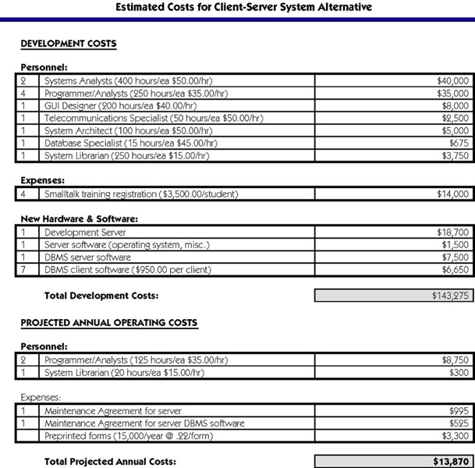
Costs for a Proposed Solution
Notes:
Teaching Notes
We often walk through this line-by-line. Though this is not representative of every information system project, it does illustrate typical costs. For instance, note that programmer/analysts are needed after the system goes into operation. Users always want some revisions.

Slide 15
Payback Analysis
Payback analysis – a technique for determining if and when an investment will pay for itself.
Payback period – the period of time that will lapse before accrued benefits overtake accrued and continuing costs.
Notes:
No additional notes.

Slide 16
Return-on-Investment Analysis (ROI)
Return-on-Investment (ROA) analysis – a technique that compares the lifetime profitability of alternative solutions.
The ROI for a solution or project is a percentage rate that measures the relationship between the amount the business gets back from an investment and the amount invested.
Lifetime ROI = (estimated lifetime benefits – estimated lifetime costs) / estimated lifetime costs
Annual ROI = lifetime ROI / lifetime of the system
Notes:
No additional notes.

Slide 17
Feasibility Analysis Matrix
Feasibility Analysis Matrix – a tool used to rank candidate systems.
 | Weighting | Candidate 1 | Candidate 2 | Candidate 3
Description
Operational Feasibility
Cultural Feasibility
Technical Feasibility
Schedule Feasibility
Economic Feasibility
Legal Feasibility
Ranking
Notes:
Teaching Notes
The weightings serve to make some kinds of feasibility more important in the rankings than others kinds.
The weightings should add up to 100%.

Slide 18

Thanks for your attention!
Any Question?
Email me on : junaid.akram@xmu.edu.my

